Slide 1


Slide 2
Agenda
What is AWC
What is declarative UI
Artifacts of Declarative UI
What all we can do in AWC
Navigation through AWC : https://www.youtube.com/watch?v=xY_9TLfTHAY
Global Search
Global navigation toolbar
Tiles and collection
One step and Tool and Info command renamed as right toolbar , navigation toolbar
Breadcrumb
Filters (Global search)
Style sheets
Info , Summary ,create stylsheet, DCP (P2S and S2P),Conditional Content , HTML panel in stylesheet.
How to create tile https://www.youtube.com/watch?v=X6uLJ9LsAx4
What is tile collection.
Active Workspace BMIDE Configuration Indexing custom business objects (BMIDE part)
Runtime properties cant be indexed.

Slide 3
What is AWC
It is an IT-friendly client for Teamcenter with a zero-install footprint and web browser access that provides an identical and seamless experience on any computing or smart device.
It is an HTML file application. It is a modern innovative and easy interface to participate in Product Lifecycle Management (PLM) business process. One can access AWC by using Computer, a tablet or a smartphone.

Slide 4
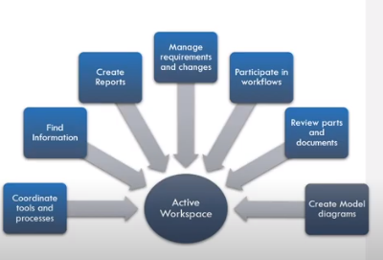
ActiveWorkSpace workouts

Slide 5
What is GWT
Google Web Toolkit (GWT) is a development toolkit to create RICH Internet Applications
GWT is a framework to build large scale and high performance web appliation while keeping them as easy-to-maintain.
Disadvantages
Not Indexable − Web pages generated by GWT would not be indexed by search engines because these applications are generated dynamically.
Not Degradable − If your application user disables Javascript then user will just see the basic page and nothing more.
Not Designer's Friendly − GWT is not suitable for web designers who prefer using plain HTML with placeholders for inserting dynamic content at later point in time.

Slide 6
What is declarative UI
New capability provided by Active Workspace that allows for a concise, codeless and prescriptive definition of the UI view content, along with its layout, routing, and behaviors.
Actions, messages, events, service calls and their inputs/outputs can be mapped and described. It provides an abstracted means of declaratively defining the client UI and its behaviors so that how it’s implemention is hidden.

Slide 7
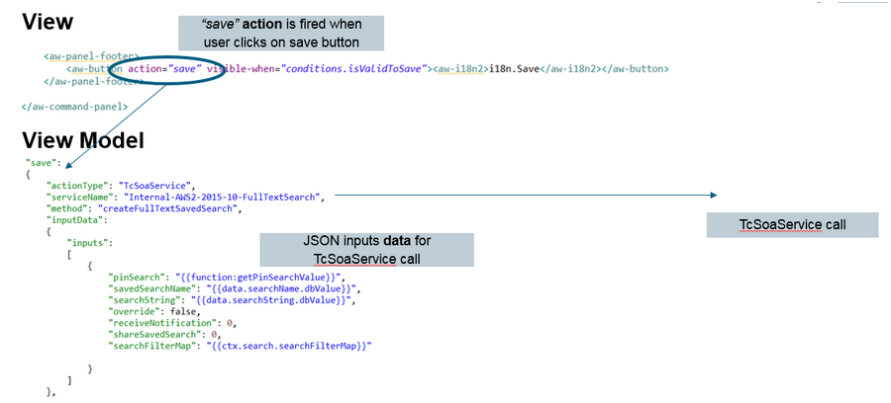
Artifacts of a declarative UI

Slide 8
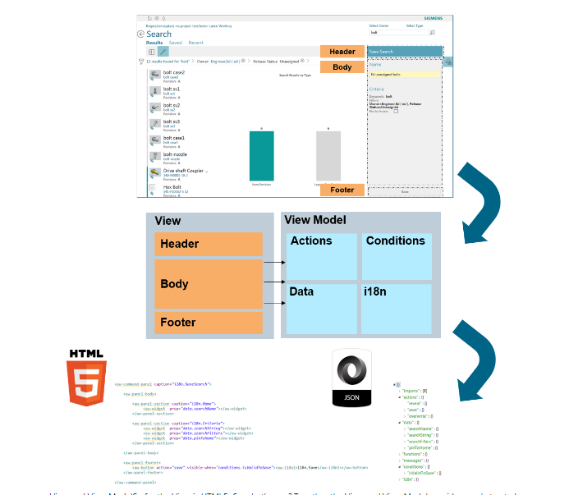

Slide 9
Interface Introduction
Global Search , Pagination and Breadcrumb, different type of views : List , List with Summary and Table view
https://www.youtube.com/watch?v=HsIGH4rfquE
Global Navigation Area: Quick access to commands like home page, back etc…
https://www.youtube.com/watch?v=xY_9TLfTHAY

Slide 10
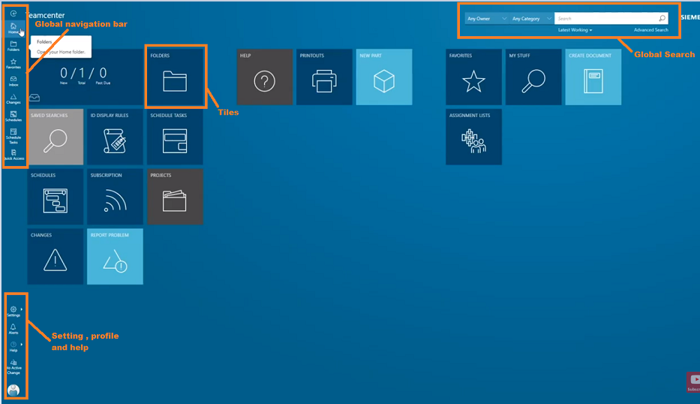

Slide 11
Stylesheets
We have below url to check which stylesheet is called on which object.
http://192.168.80.114:3000/#/xrteditor
XRT editor doesn’t work in workspace named Author.

Slide 12
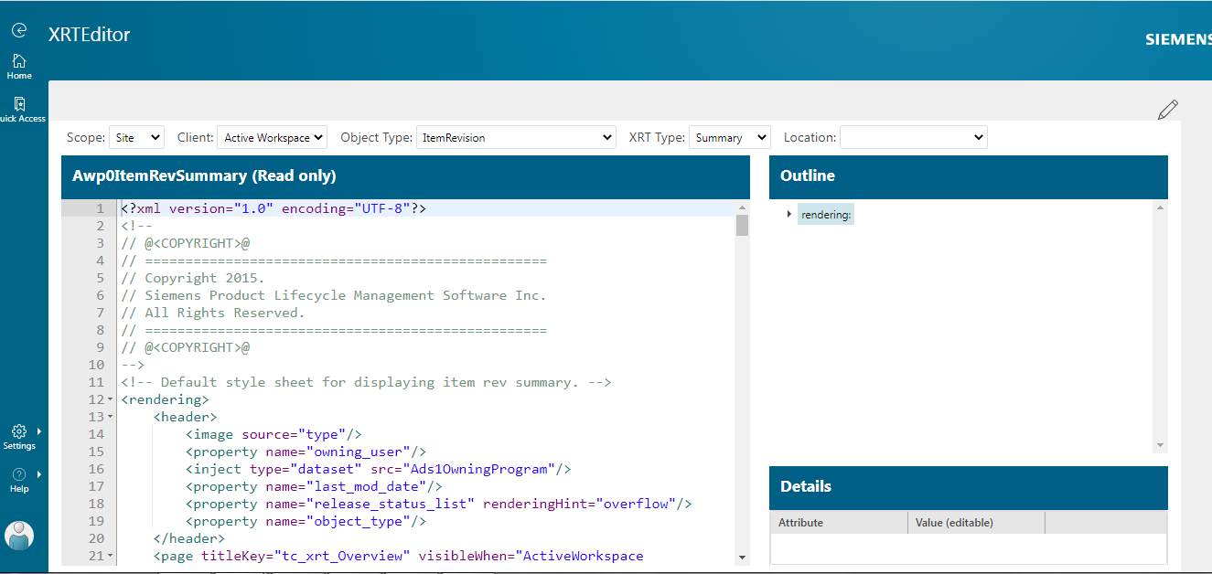

Slide 13
Different declarations in Stylsheets
<content visibleWhen="ap4_is_project_member==true">
<command commandId="AP4_AddParticipants" renderingHint="commandbutton" />
</content>
<tableDisplay>
<property name="fnd0AssigneeUser" />
</tableDisplay>
<objectSet source="AP4_SubActivityRelation.AP4_SubActivityRevision" sortdirection="ascending" sortby="object_string" defaultdisplay="tableDisplay">

Slide 14
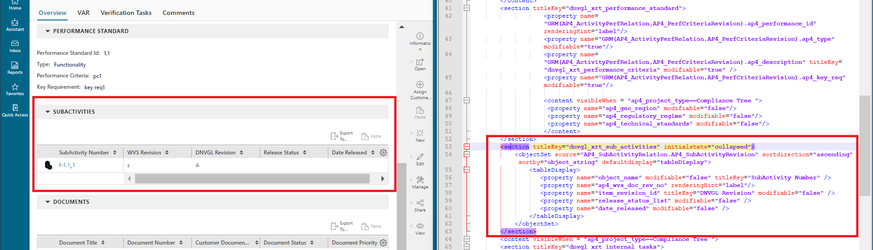
Object Set

Slide 15
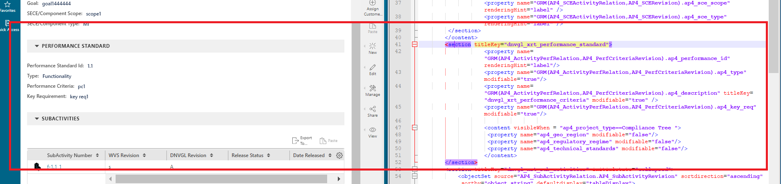
GRM
<property name="GRM(AP4_ActivityPerfRelation,AP4_PerfCriteriaRevision).ap4_performance_id" renderingHint="label"/>

Slide 16
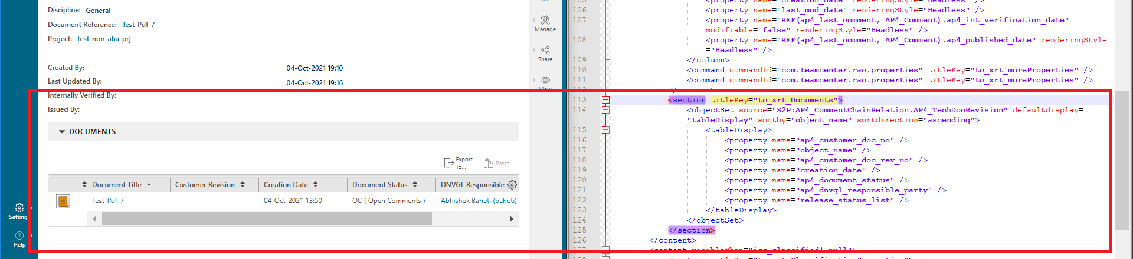
S2P
<objectSet source="S2P:AP4_ChildActivity.AP4_ProjectRevision.b" defaultdisplay="listDisplay" sortby="object_string" sortdirection="ascending">
</objectSet>

Slide 17
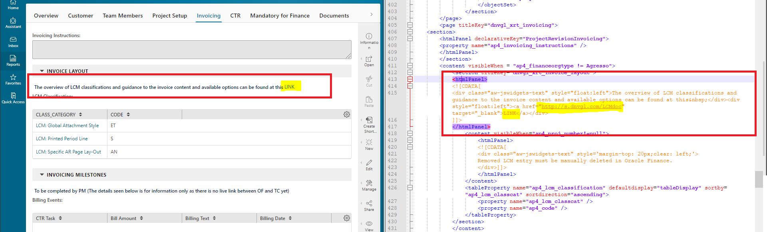
Hyperlink
<htmlPanel>
<![CDATA[<a href=“” target="_blank"> Competence Search</a>]]>
</htmlPanel>
This is not changed to
<htmlPanel declarativeKey="ABACharts"> </htmlPanel>

Slide 18
What is Tile collection and Tile
A tile collection is a container for the tiles assigned to a given scope object maintains relations to a number of tile objects using Awp0GatewayTileRel relations
Tile object is created using a tile template object.
https://www.youtube.com/watch?v=X6uLJ9LsAx4.

Slide 19
How to create commands
Previously we use to call it as one step and tools and info commands but now its renamed as right toolbar.
Darsi is one way by which you can create the commands define action etc…
host:port/?dev

Slide 20
Continue…
npm run exportToSrc this will help you to make the darsi command part of your war/package
Above PDF will help you to explore more on Dev tool.

Slide 21
How to make any property indexed

Slide 22


